Slide 1
Final THT Fall 2021 CSC 342/343 Izidor Gertner
By : Chue Zhang

Slide 2
Objective
To test runtime between optimized and unoptimized dot products in visual studios 2019
Optimized would mean that we turn on auto parallelization and vectorization and unoptimized would have both off
I will be doing up to 2^25 vector size

Slide 3
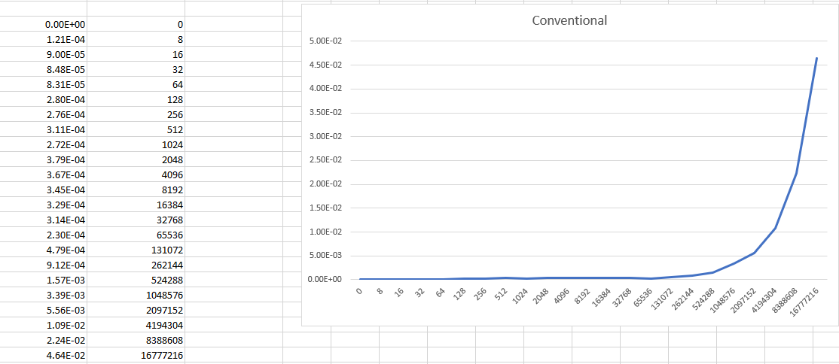
Conventional(unoptimized)

Slide 4
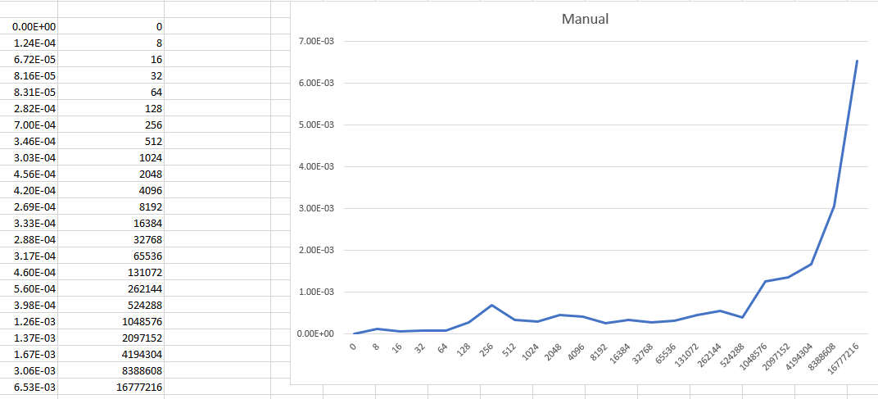
Manual (unoptimized)

Slide 5
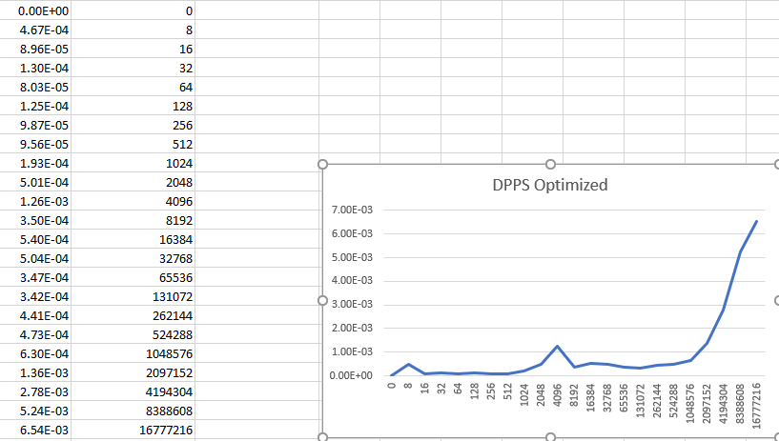
DPPS (unoptimized)

Slide 6
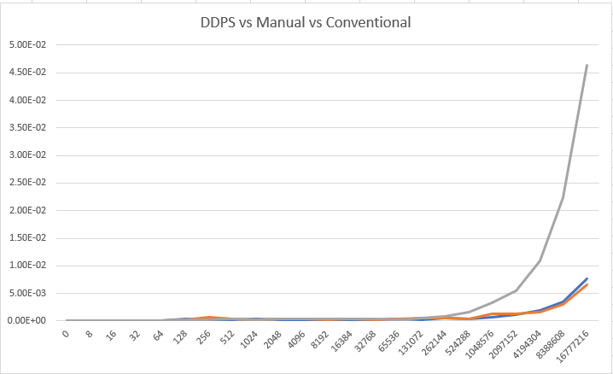
All unoptimized

Slide 7
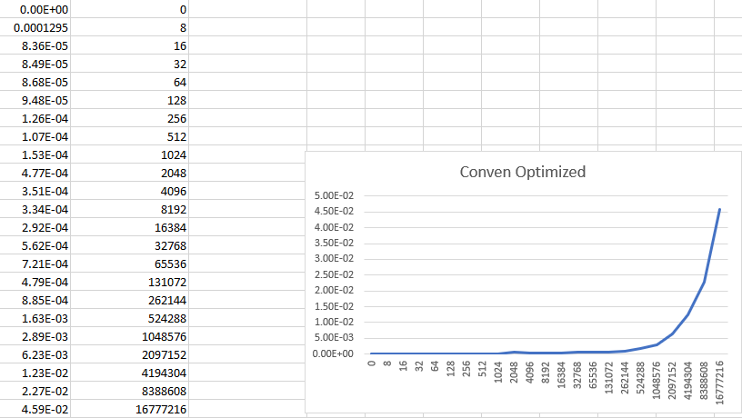
conventional(optimized)

Slide 8
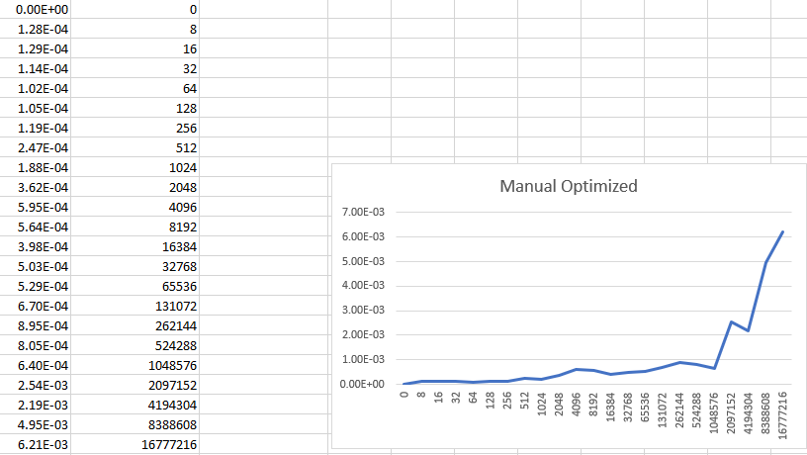
manual(optimized)

Slide 9
DPPS(optimized)

Slide 10
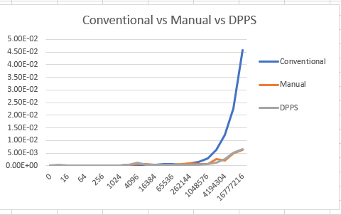
all(optimized)

Slide 11
Conclusion
For me, there was not much difference in runtime for both unoptimized and optimized version.
The main similarity was that everything has a quadratic run time and in both unoptimized and optimized screenshots, manual mirrors DPPS and is both faster than the conventional method.

